Slide 1
BRITISH AIRWAYS
WEB SCRAPPING TO GAIN COMPANY INSIGHTS AND CUSTOMER REVIEWS TOWARDS THEIR EXPERIENCE WITH BRITISH AIRWAYS 21-08-2023

Slide 2
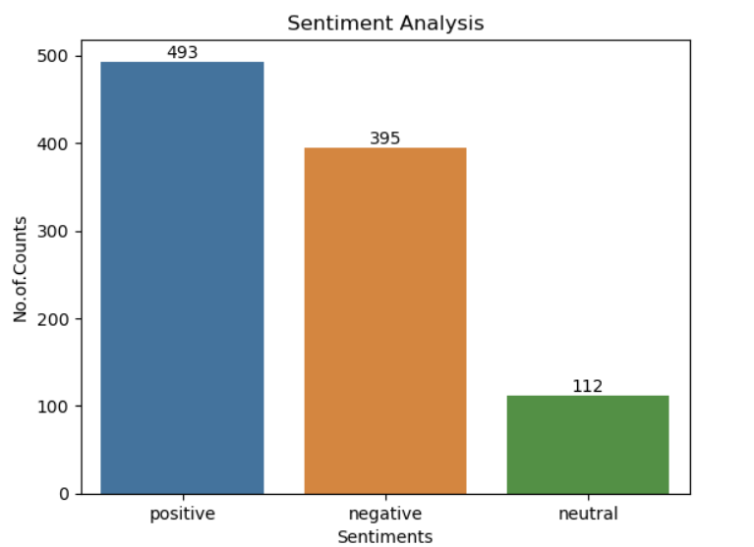
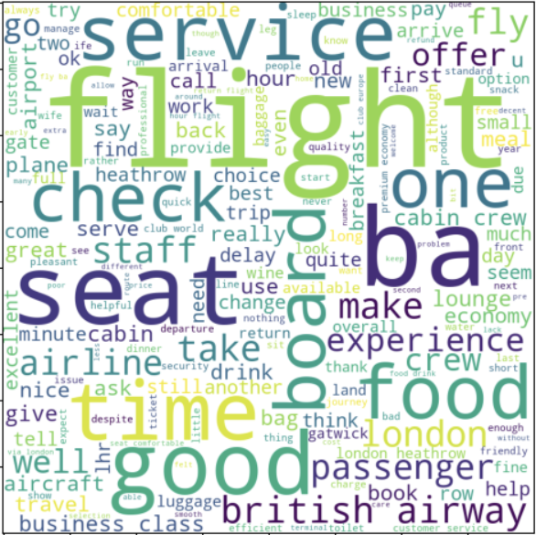
INSIGHTS FROM CUSTOMER REVIEWS
Scrapped and cleaned 1000 reviews from the website. The obtained result is
POSITIVE REVIEWS – 493
NEGATIVE REVIEWS – 395
NEUTRAL REVIEWS – 112
Word Cloud of Keywords used in Positive Reviews:

